Slide 1
Experiment no 11
To Perform Estimation of effort using FP Estimation for chosen system

Slide 2
Description
A function point is a "unit of measurement" to express the amount of business functionality an information system (as a product) provides to a user. Function points are used to compute a functional size measurement (FSM) of software.
The principle of Albrecht’s function point analysis (FPA) is that a system is decomposed into functional units.
Inputs: information entering the system
Outputs: information leaving the system
Enquiries: requests for instant access to information
Internal logical files: information held within the system
External interface files: information held by other system that is used by the system being analysed .

Slide 3
Various FPA Functional Units are:-

Slide 4
Categorisation of Functional Unit
The five functional units are divided in two categories:
(i) Data function types
Internal Logical Files (ILF): A user identifiable group of logical related data or control information maintained within the system.
External Interface files (EIF): A user identifiable group of logically related data or control information referenced by the system, but maintained within another system. This means that EIF counted for one system, may be an ILF in another system.

Slide 5
(ii) Transactional function types
External Input (EI): An EI processes data or control information that comes from outside the system. The EI is an elementary process, which is the smallest unit of activity that is meaningful to the end user in the business.
External Output (EO): An EO is an elementary process that generate data or control information to be sent outside the system.
External Inquiry (EQ): An EQ is an elementary process that is made up to an input-output combination that results in data retrieval.

Slide 6
Special Features
Function point approach is independent of the language, tools, or methodologies used for implementation; i.e. they do not take into consideration programming languages, data base management systems, processing hardware or any other data base technology.
Function points can be estimated from requirement specification or design specification, thus making it possible to estimate development efforts in early phases of development
Function points are directly linked to the statement of requirements; any change of requirements can easily be followed by a re-estimate.
Function points are based on the system user’s external view of the system, non-technical users of the software system have a better understanding of what function points are measuring.

Slide 7
Standard Weighting Factors

Slide 8
Performance Instruction
Observe functional units and their weighting factors.
Compute them in formula to find value of UFP count.
Find value of FP by using formula.

Slide 9
Sample Problem Statement
Consider a project with the following parameters.
(i)External Inputs:
(a) 10 with low complexity
(b)15 with average complexity
(c) 17 with high complexity

Slide 10
(ii)External Outputs:
(a) 6 with low complexity
(b)13 with high complexity
(iii)External Inquiries:
(a)3 with low complexity
(b)4 with average complexity
(c)2 with high complexity

Slide 11
(iv)Internal logical files:
(a) 2 with average complexity
(b)1 with high complexity
(v)External Interface files:
(a) 9 with low complexity
In addition to above, system requires Significant data communication
ii. Performance is very critical
iii. Designed code may be moderately reusable
iv. System is not designed for multiple installation in different organizations.
Other complexity adjustment factors are treated as average. Compute the function points for the project.

Slide 12
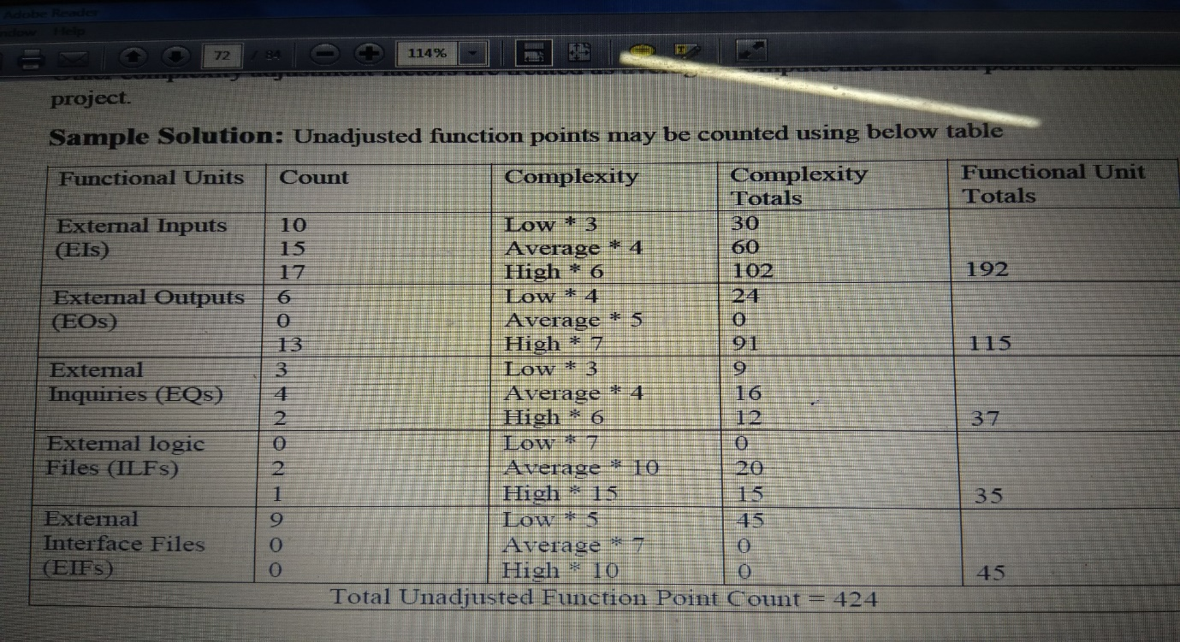
Functional Point Estimation for Railway Reservation System

Slide 13
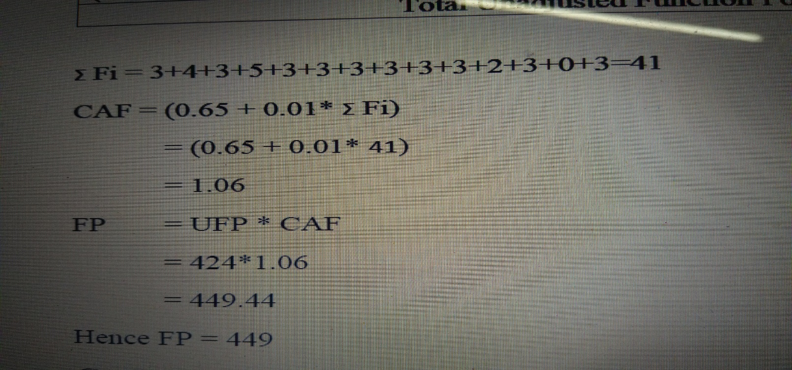
Calculation of Functional Point

Slide 14
Thank You

